Slide 1
FISHING
Our team has used the OpenGL Utility ToolKit to execute fisherman fishing animation

Slide 2
Table of contents
01
02
03
04
Fishes
Fisherman
Catching Fish
End-Screen
The screen displays the fishes swimming in water
The Fisherman is displayed on the screen
The Fishing Rod is displayed and the fisherman catches the fish
The Fishes that are caught are displayed on the screen

Slide 3
— Just Sul
“Fishing in the right pond is better than fishing in the wrong river.”

Slide 4
Workflow of our Application
1st
4th
Intro Screen with fishes swimming
Fishes are shown lying on the ground
2nd
3rd
Fisherman coming to the shoreside to catch the fishes
Fisherman catches the fish with the help of rod.

Slide 5
01
INTRO
The fishes can be seen swimming in the water ululul

Slide 6
Fishes swimming in water
This slide shows multiple fishes swimming inside the water. Here , we used the concept of polygons( triangles for fishes ) in OpenGL to create fishes of different sizes and the translate function to show the animation in the same

Slide 7
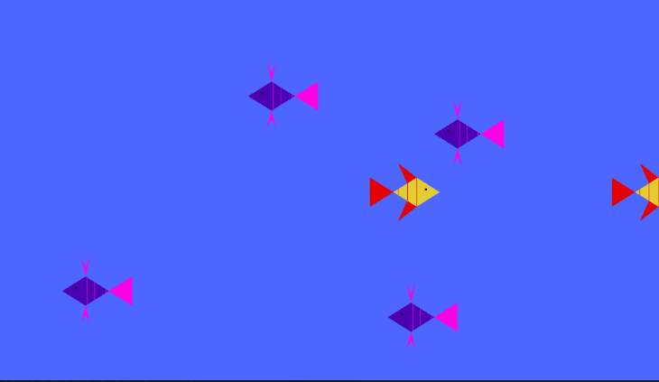

The slide title goes here
Screenshot of the fishes swimming in the water
Do you know what helps you make your point clear?
Lists like this one:
They’re simple
You can organize your ideas clearly
You’ll never forget to buy milk!
And the most important thing: the audience won’t miss the point of your presentation

Slide 8
FISHERMAN
02
The fisherman can be seen coming to the shoreside

Slide 9
Fisherman walking to the shore
This slide shows the fisherman walking up to the shore with a fishing rod in his hand . Here we again use the concept of polygons (lines , circles and triangle) and the translate function to show the animation in the fisherman

Slide 10
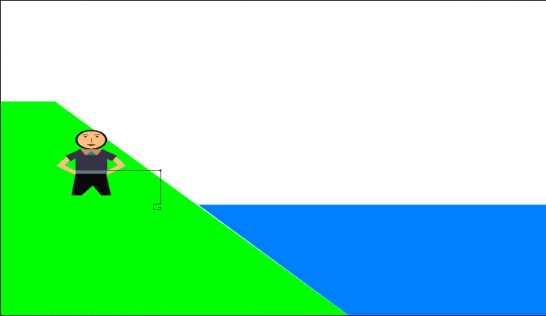
Make your idea understandable
FISHERMAN COMING TO THE SHORE
Mars
12%
Jupiter
38%
Venus
42%
Mercury is the closest planet to the Sun and the smallest one in the Solar System
2
3
4
7
1

Slide 11
CATCHING FISH
03
The fishing rod is displayed and the fisherman catches the fishes

Slide 12
Catching the fish
This slide shows multiple fishes swimming inside the water and a fishing rod which then catches the fish. We use the concept of polygons( triangles and rectangles ) and the translate function to begin about the animation

Slide 13
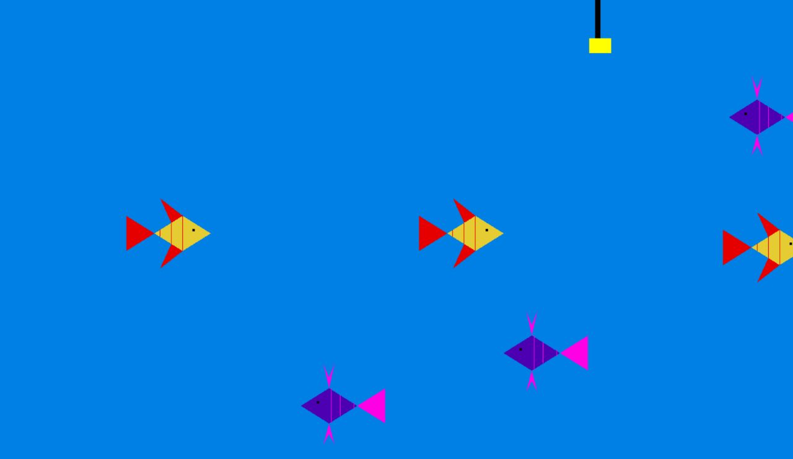
Fishing Rod is Displayed on Screen

Slide 14
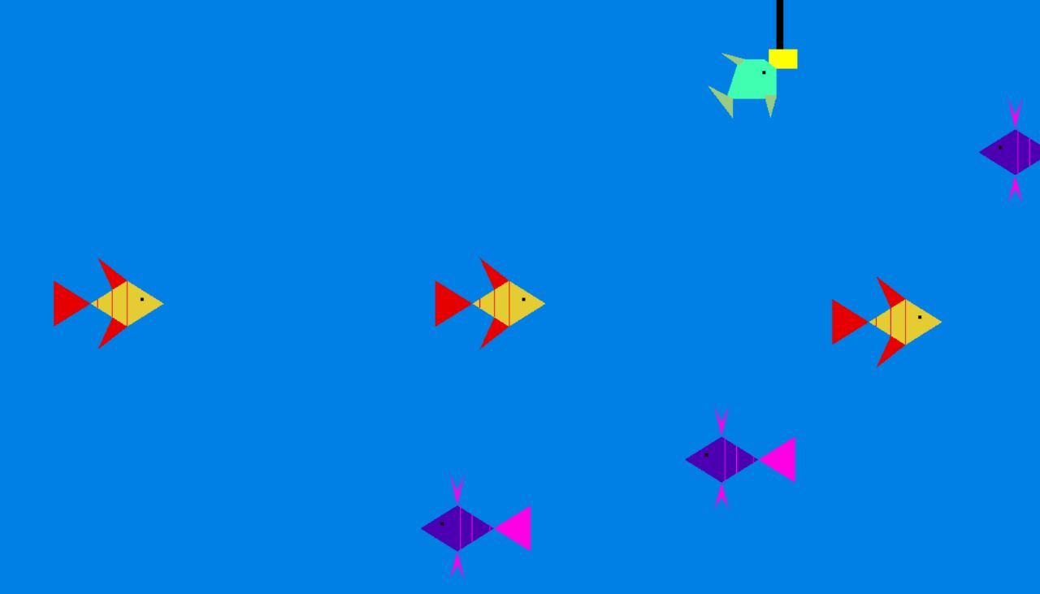
Fish caught to the rod is displayed

Slide 15
END-SCREEN
04
The fisherman can be seen with the fishes that he has caught

Slide 16
Fisherman with the caught fishes
This slide shows the fisherman along with the fishes that he has caught on the shoreside . Here we again use the concept of polygons (lines , circles , triangles and rectangles) to create the fisherman , the rod and the fishes.

Slide 17
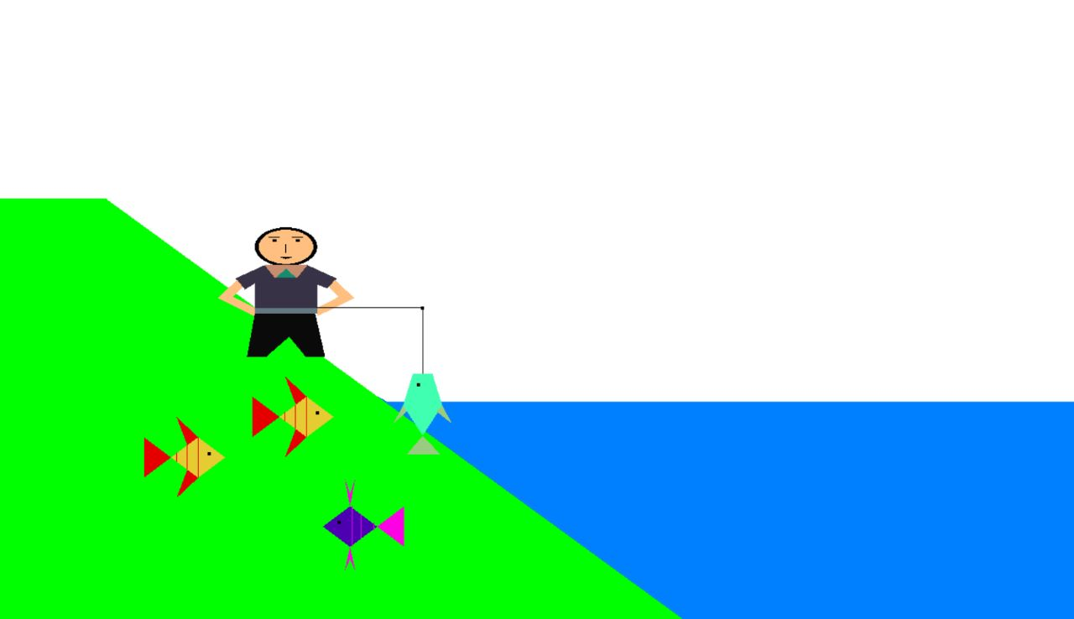
The Fishes that are caught are displayed on the screen

Slide 18
Our Team
Madhur Saxena - S20200010115
Samyak Bansal - S20200010186
Abhay Kumar Ray - S20200010002
Yash Gupta - S20200010234

Slide 19
Thank you
KGKMKB

